Slide 1


MNAMBITHI
TVET COLLEGE
OPEN LEARNING
2025
INDUCTION PROGRAMME Semester/Trimester 1
Notes:
Good morning Ladies and gentlemen and welcome to the Mnambithi TVET College open learning induction for Semester 2 2024. My name is Skhumbuzo Kweyama and I am the Open Learning Administrator. Should you have any questions please note them and ask during the question and answer session at the end of the induction.

Slide 2
Introduction to Open Learning
The Open Learning is a blended learning programme to assist students who are:
  Wanting to study while being employed
  Needing to finish up outstanding subjects and cannot register on campus
Computers/laptops are essential for attending the contact sessions which are either virtual for theory subjects or face-to-face for the practical subjects.
Mnambithi TVET provides free student WiFi on the campuses to assist enrolled students in attending/sending/receiving assignments etc.
Notes:
Open learning is a blended learning programme this means that it has two components: Virtual (online) contact session/s and face to face contact session/s for subjects that are practical in nature.
What needs to be noted that 90% of this blended learning is self study. The 10% that makes up the rest is for contact sessions where difficult sections or more technical aspects of the modules are discussed. This is also where your preparation for the assessments are covered.
For connectivity, students may visit their slected campus for connectivity.

Slide 3
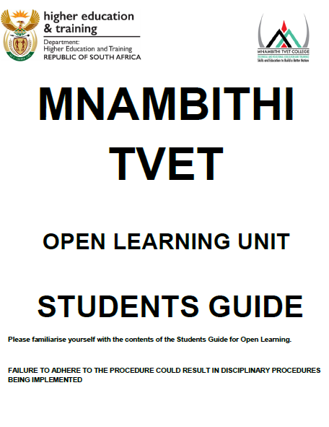
STUDENTS GUIDE
IMPORTANT POINTS:
Students guide highlights the procedures you need to follow as an open learning student
Do not hand in your assignments to your facilitators
4 contact sessions of 1 hour for theory subjects (virtual)
4 contact sessions of 2 hours for practical subjects
Notes:
The Mnambithi TVET Open Learning Students Guide outlines all the important information you need to successfully navigate your semester with us.
It is important to make sure that you have familiarised yourself with the students guide as it outlines procedure for handing in assignments
How to deal with queries
National examination procedures

Slide 4
Assessments
Semester programs:
  2 Assessments and 1 internal examination make up your year mark (ICASS)
  To qualify to write the internal Examination you have to have completed both assessments
Trimester programmes:
2 Assessments make up your year mark (ICASS)
Inform the Open Learning admin via email: mnambithi.openlearning@kzntvet.edu.za and include the reason you will not be meeting the deadline.
Notes:
If there is a clash for a subject for your internal examination. You are to send the open learning admin an email to request that an arrangement be made for you. This can only be done for internal assessments, and does not count for the NATIONAL EXAMINATION.

Slide 5
What do you need to succeed?
Resources:
  The internet! Research is an important part of self-study please use the internet to research assessments etc.
  Text books – issued once registration is completed.
  You-tube for practical subjects there are hundreds of videos uploaded on you tube that you can view to assist you with difficult concepts.
Notes:
Do not rely solely on textbooks they are just another resource. As this is aimed at Higher Education and Training we encourage you to do research as well.

Slide 6
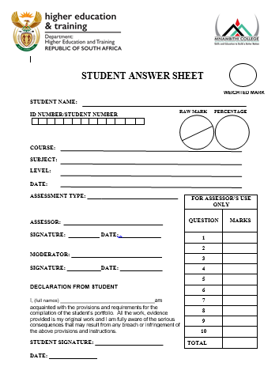
Assignments:
The ICASS (year mark is generated by submitting:
2 Assessments
1 Internal examination
Trimester:
2 Assessments
The due dates for the assessments are in
the updated schedules that were emailed/
Student Portal to you.
Notes:
Semester programme.
Assessment 1 covers 25 % of the work
Assessment 2 covers 50% of the work
Internal Examination 70 – 80% of the work

Slide 7
ICASS & SUB MINIMUM REQUIREMENTS
ICASS
  The pass mark for your subjects is 40% you must have a year mark that is a pass for you to be eligible to write the national examination (sub minimum requirement)
  ICASS WEIGHTINGS
  Assessment 1: 20%
  Assessment 2: 30% 40% of Final Mark
  Internal Examination: 50%
  National Examination 60% of Final Mark
  TRIMESTER
  Assessment 1: 30%
  Assessment 2: 70 %
  National Examination: 50 %
50 %
Notes:
The ICASS (year Mark) is extremely important as the Department of Higher Education and Training will not allow you to sit for the National Examination unless you have passed your Year Mark. Work Hard and do your best in everything you do.

Slide 8
WHAT HAPPENS IF I FAIL MY ICASS/YEAR MARK
You will not be allowed to write the National Examination as you do not meet the sub-minimum requirement for that subject.
That means you have completed the semester/trimester and you have failed before you have even sat for the examinations. You will have to re-enrol to complete the subject in the next trimester/semester and have to do ALL the assessments AGAIN!
This is why it is important to hand in ALL your assessments and Sit for the Internal Examination
WHAT HAPPENS IF I FAIL THE NATIONAL EXAMINATIONS
If you qualified to sit for the national examinations but failed the subject during the examination's. Because your ICASS/year mark is a pass you will be allowed to register to write the examination only in the next semester
Notes:
It’s important to hand in assessments and pass your assessments.
We only have 2 examination sessions for B/S courses and 3 examination sessions for Engineering studies.

Slide 9
CONTACT SESSIONS
Notes:
There are TWO types of contact sessions at Mnambithi TVET College:
Virtual – online the link will be sent to you once and you will use the same link for the virtual contact sessions scheduled after that.
Face – to – face: These contact sessions are conducted on the campuses where you have registered to write the National examination.
If you are not going to make it to the contact session, your lecturers details will be sent to you and you need to contact them to let them know you are not going to make it.
If we need to reschedule or move the contact session your facilitator will send you a message to inform you of when the new date will be

Slide 10
How do I get My assessments?
We will upload the assessments on the student portal at least TWO weeks before the due date to allow you time to research and prepare for them.
The due date for an assessment is indicated at the bottom right in the contact session schedule.
How do I SUBMIT my assessments?
ALL assessments must have a student cover page attached to them. With the correct subject, level etc. on the cover page
Save them as a PDF document;
Upload them on student portal under correct subject registered for.
Notes:
No assignment will be sent via email.
Use an official email address: mnambithi.openlearning@KZNTVET.EDU.ZA to ask for assistant.
Moodle to be used as a way of send and submitting the assignment.

Slide 11
INTERNAL EXAMINATIONS
The internal examination will be written at the Ladysmith Campus. The timetable will be loaded on the portal.
The duration for the internal examination is TWO hours per subject.
It is your responsibility to inform the open learning admin of any clashes immediately so that we can try and accommodate you.
Notes:
The internal examination is only applicable to the SEMESTER COURSES
Info open learning admin if you have clashes so that we can make arrengements

Slide 12
DEREGISTRATION
If for whatever reason you cannot continue with the open learning programme you will have to deregister:
This will ensure that you are not charged for the whole semester/trimester
You can only deregister if you have not submitted any assignments.
Contact the open learning Admin team and complete the deregistration form and submit the documentation.
Notes:
Deregistration can only be done before 12 February 2024 – after this date registration entries will have been sent to DHET

Slide 13
How to lodge a complaint:
Complaints are taken very seriously and we appreciate the feedback from you the students.
VALID COMPLAINTS
Facilitators not arriving/logging on for a contact session.
Assessments not covered in the text book.
Lodging a complaint:
all complaints need to be in writing so send an email to: mnambithi.openlearning@kzntvet.edu.za
Notes:
Don’t complain after you have failed your ICASS, as soon as you see that something is not right please lodge a written complain.

Slide 14
Questions and Answer session

